Slide 1
Teaching in multicultural & multilingual classrooms
Thinking …
Found the answer
friend’s advice
EMILY SUM

Slide 2
Onsite support
Implementation
Design
Reflection
Design research/ studies to investigate and support mathematics students’ learning
Collaborative Lesson Planning (CLP)
Identify possible difficulties/ obstacles in the focal domain
Lesson Observation (LO)
Enact design instruction during the lesson
Post-lesson Reflection
Plan and prepare for upcoming lessons by designing/ revising tasks to improve instructional design
Share/ discuss on the implementation approach and observations
Analysis what transpired in the classroom
Specify goals for students’ learning
Design/ revise existing instructional tasks and other materials
Determine the means of support
Data collection, including interviews

Slide 3
Collaborative Lesson Planning (CLP)
OUR GOAL: To develop conceptual understanding as well as procedural fluency.
Unit of study: Basic multiplication (2N3)
EM students
Do not understand the concept of multiplication
Cannot recite times tables, nor to recall/ use multiplication facts
Cannot formulate number sentence to solve multiplication problem
HK students
Learn multiplication procedurally, lacking conceptual understanding of the operation

Slide 4
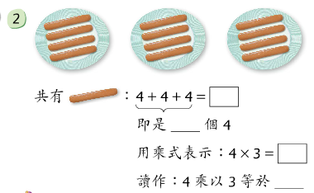
Collaborative Lesson Planning (CLP)
Teaching basic multiplication (2N3)
Language issues
Three fours are twelve 3 × 4 = 12 (NCTM)
4 × 3 = 12??
Multiplied by
Instructional starting point

Slide 5
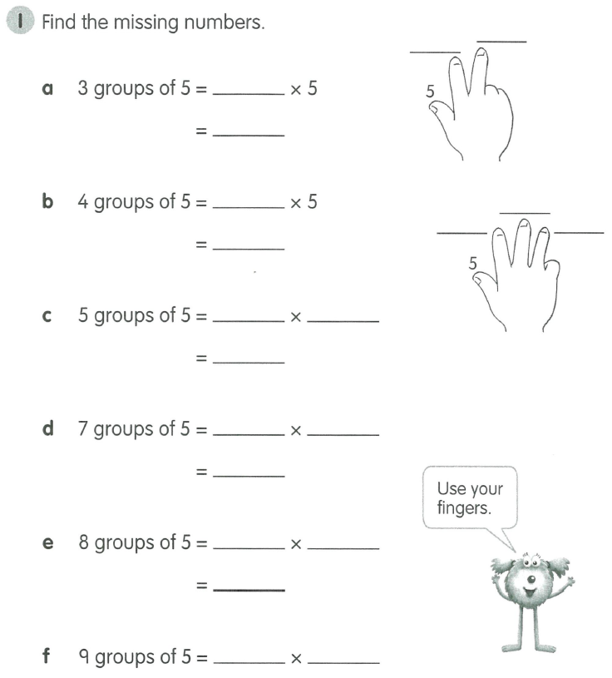
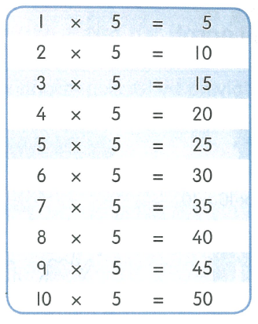
Learning content analysis
To support the development of teachers’ knowledge about the teaching of multiplication.
Textbooks from UK and Finland

Slide 6
culture matters
What Ethnic Minority Primary Students in Hong Kong Value in Mathematics Learning?
C2 Activities
Mathematics Games
Stories about Mathematics / Mathematicians
C3 Practices
Practicing with lots of Questions
Doing a lot of Maths Work
Outdoor Mathematics Activates
Maths Homework
C10 Tools
Using Diagrams
Using Concrete Materials

Slide 7
Tasks, tools & Talk
(Askew 2012 & 2015)
“Preparing for and enacting teaching was more secure when based upon careful choice of tasks, supported by a range of tools that extend our “natural’ abilities and held together by careful attention to classroom talk”.
Connect the 5 multiplication table to the divisions on the clock face (see picture).

Slide 8
Tasks, tools & Talk
How can maths teaching be more culturally responsive for diverse students, and by extension, be more effective?
Develop effective teaching and learning strategies
By using arrays, diagrams, manipulatives…
Design school-based curriculum including relevant teaching, learning and assessment resources
Rearrange teaching sequences (2-5-10-3-6-4-8-7-9)
New worksheets with the use of a range of materials and contexts
Through doubling, students connect the 5-10, 3-6 and 4-8 multiplication tables.

Slide 9
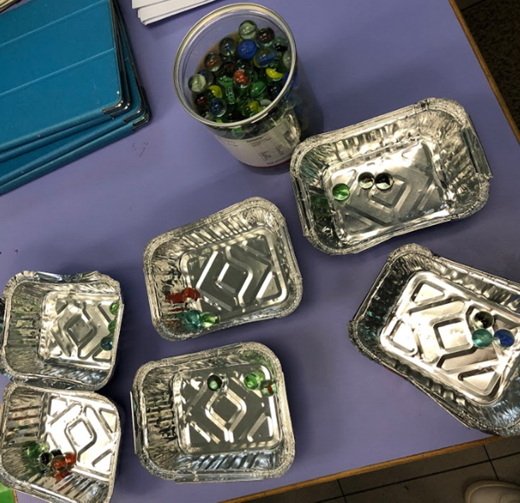
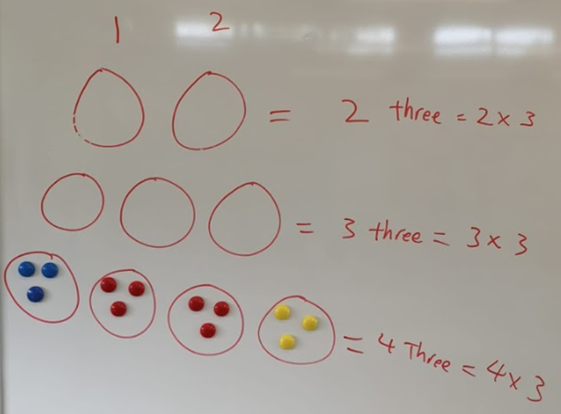
Tasks, tools & Talk
Enacting design instruction during the lesson
TALK
TOOLS
TASKS
Use simple language to describe multiplication, “times”, 2 threes, 3 threes…

Slide 10
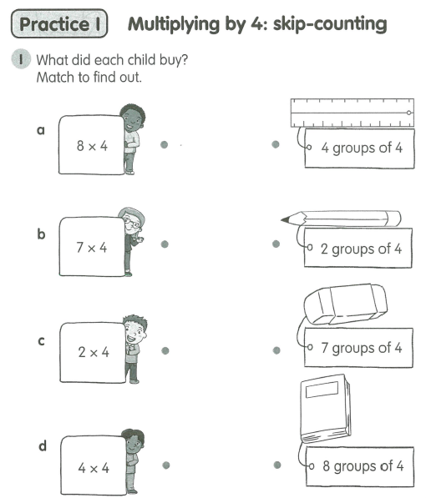
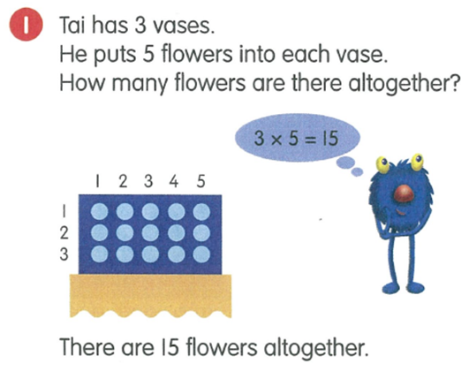
Strategies for instruction
Putting all the pieces together in planning a set of lessons
TALK
Avoid passive construction, “multiplied by”
TOOLS
TASKS
Hands-activities using technology and manipulatives
Use graphical/ pictorial representations, such as arrays/ area models
Teach the discourse styles expected in class

Slide 11
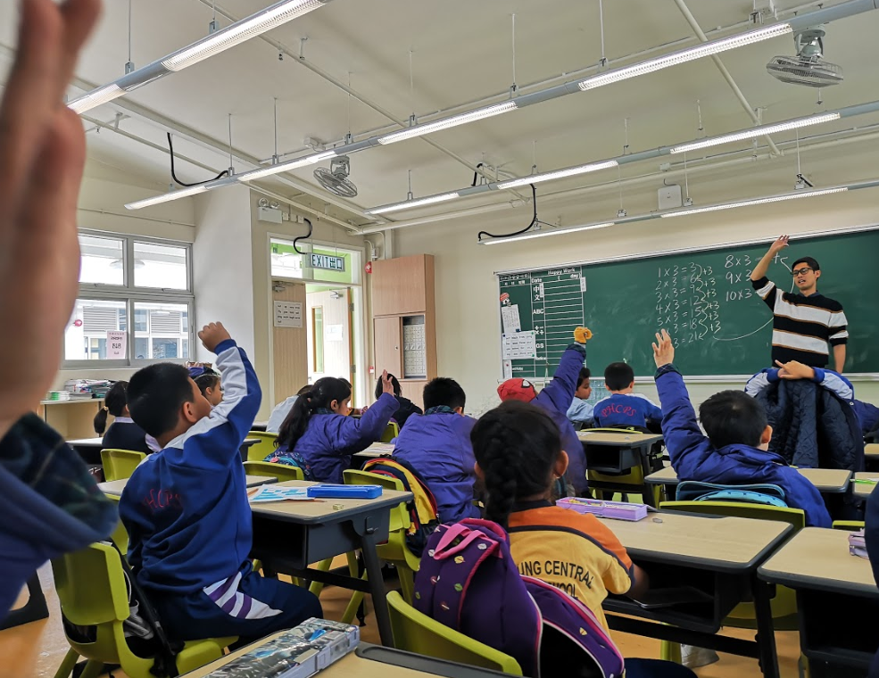
Beyond algorithm
Develop conceptual understanding using Cuisenaire rods

Slide 12
Beyond algorithm
Develop conceptual understanding using Cuisenaire rods
By looking at the columns of the array, students can interpret the array as n columns of 3 (or n groups of 3).
Students may skip count the number in each column, 3, 6, 9, 12 and then know that 4 columns of 3 is 12, or 4 × 3 = 12

Slide 13
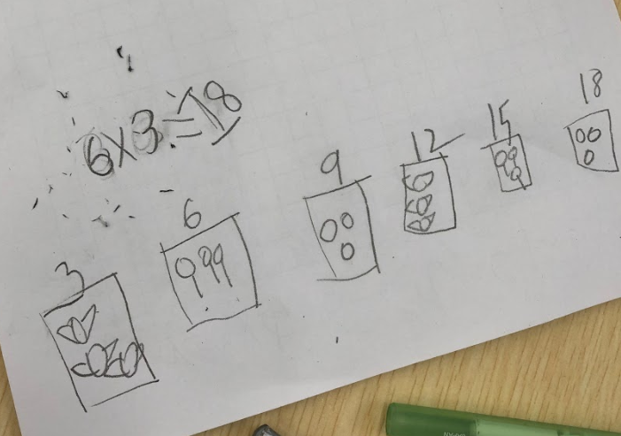
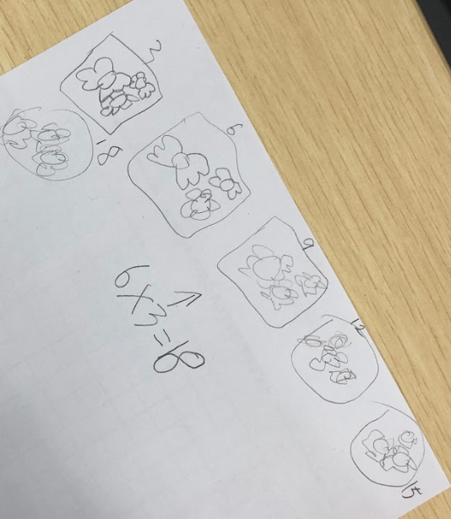
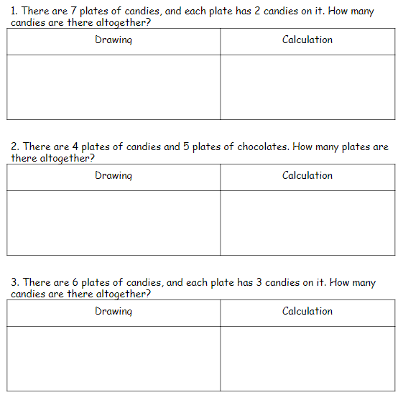
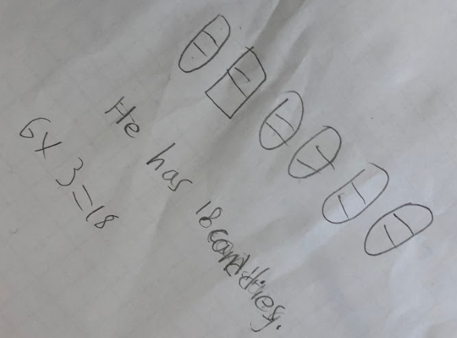
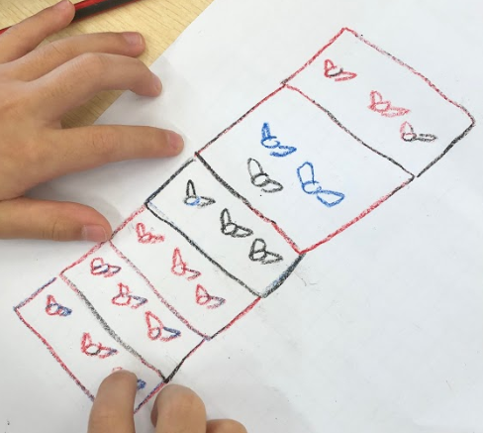
Beyond algorithm
Develop conceptual understanding as well as procedural knowledge
(Askew, 2016, p. 47)

Slide 14
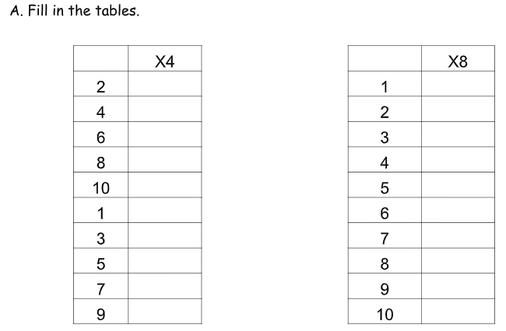
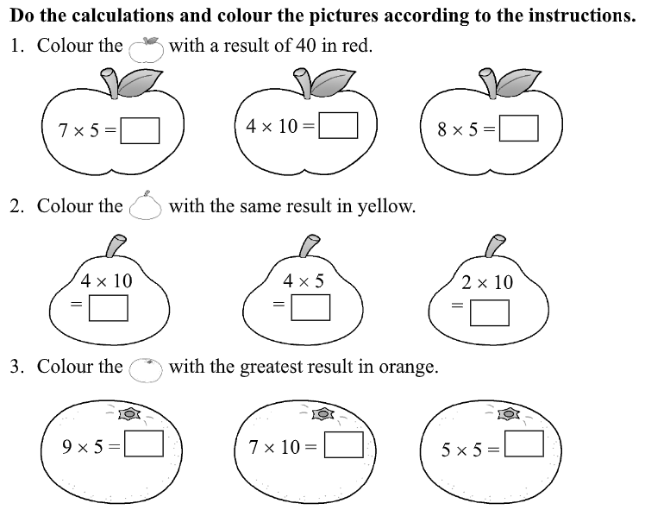
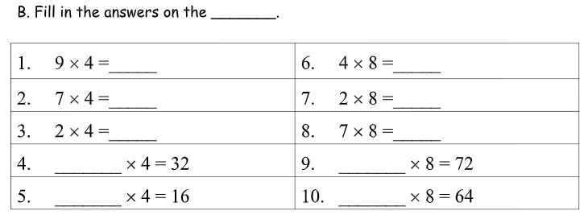
Exercise counts
Practice to become fluent in the 5-10 & 4-8 multiplication tables and connect them to each other.

Slide 15
Collaborative learning, reflection, community and social support.
Professional Learning Community on Facebook

Slide 16
QUESTION &
ANSWERS

Slide 17
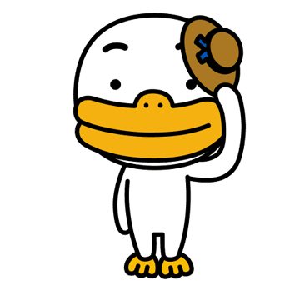
THANK YOU
siwan@hku.hk

