Slide 1
$$1+\frac{1}{2}+\frac{1}{3}+\frac{1}{4}+\frac{1}{5}=?$$
Depth
in Fluency
TAM Chi Leung
samtcl@hku.hk
$$π≈3.14$$

Slide 2
I understand but I am not always fast
I am human so
I will make mistakes

Slide 3
A scenario
Teacher spend (and really needed to spend) a lot of time trying to help students understanding how to get the answers right with 2 or 3 important examples
Time left for class work is limited
Homework support from family is limited
So …

Slide 4
Another Scenario
Teachers are able to let the students memorize the multiplication table (English or Chinese version)
But every time some students need to spell through a sequence of expression before getting the result
Six One Six, Six Two Twelve, Six Three Eighteen, Six Four … , Six Nine Fifty-four. So $6×9=54$

Slide 5
Better Ways to Achieve Fluency?
Efficient
Practical
Students Feeling Good

Slide 6
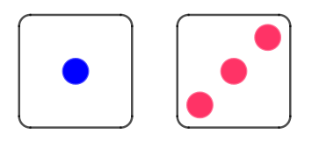
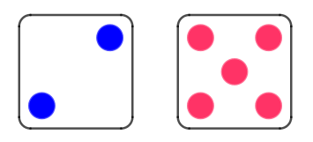
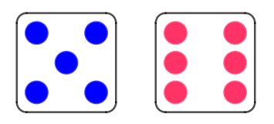
Add by Counting Dots on dices
Students throw a set of dices ten times, count the total, write down the expressions and corresponding answers.
🎲 🎲 https://www.geogebra.org/classic/wsuzqpzp
1+3 = 4
2+5 = 7
5+6 = 11

Slide 7
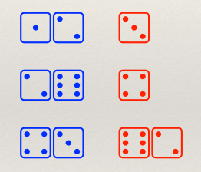
Add by Counting Dots on dices
Students generate their own questions
Students can gradually increase the difficulty
Students will eventually migrate from counting dots to mental calculation

Slide 8
Guess the number of candies in my hands
Teacher places 10 (or other number) candies on table
He grasps randomly and quickly a number of candies in his hand
He asks his students to guess the number of candies in his hand
Students may eventually discover that they can guess by calculation (with/without hints from teacher or peers)
They play the game themselves in pairs with different numbers of candies

Slide 9
Fractions/percentage with paper
Given a piece of square paper
Fold a polygon having 50% of the area of the original square
May require students to fold certain kind of polygon to increase challenge level

Slide 10
Perimeter of Polygons
Draw some polygons having equal perimeter with the given polygon
Students explore as well as calculate

Slide 11
Perimeter of Polygons
Which of the following polygons have a different perimeter? Why?

Slide 12
Area of Parallelogram
Ask students to make parallelograms with equal area but different shapes
On the process of making and verify their answers, they can consolidate the concepts of parallelogram while practicing the formula

Slide 13
Rationale
Maximize Practice
Linkage between concepts and figures / applications

