Slide 1
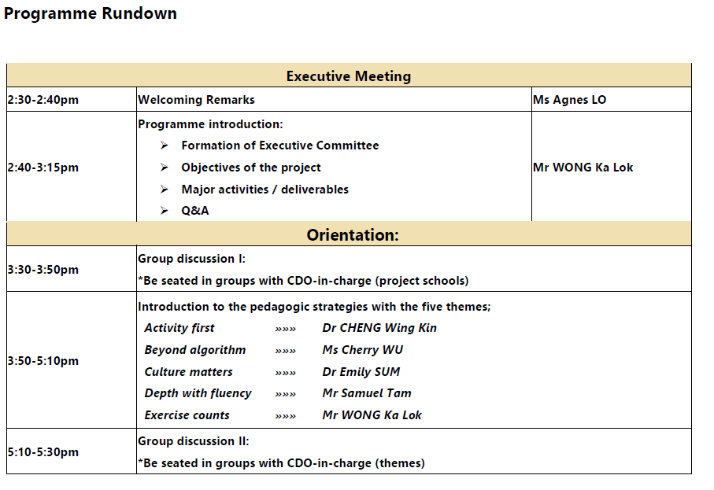

Slide 2
Supporting the Learning and Teaching of Mathematics for
Non-Chinese Speaking (NCS) Students in Primary Schools
小學非華語學生數學的學與教支援計劃
Quality Education Fund
Thematic Network 2019-20
Executive Meeting September 27, 2019

Slide 3
Project Leader:
Mr WONG Ka Lok
Team Members:
Dr KI Wing Wah
Prof LEUNG Frederick Koon Shing
Dr MOK Ida Ah Chee
Dr LEE Arthur Man Sang
Project Manager:
Ms Agnes Lo
Curriculum Development Officer:
Dr Emily Sum
Mr Samuel Tam
Dr Cheng Wing Kin
Ms Cherry Wu
Dr Queenie Poon
Senior Research Assistant:
Ms Antonia Yip

Slide 4
Background
Our Experience and Achievement
University-School Support Programmes
(USP)
Supporting the Learning and Teaching of Mathematics for Non-Chinese Speaking Students in Primary Schools (2017-19)
Supporting the Learning and Teaching of Mathematics for Non-Chinese Speaking Students in Secondary Schools (2015-17)

Slide 5
Timeline
2019
SEP
2019-2020
SEP-JAN
2020
FEB-JUN
2020
JUN
2020
JUL-AUG
Phase 1
Phase 2a
Phase 2b
Phase 3
Phase 4
Collaborative investigation & Curriculum implementation
Consolidation & Refinement
Project setup & Familiarization
Collaborative investigation & Curriculum implementation
Dissemination & Overall evaluation
Reporting & Packaging of deliverables

Slide 6
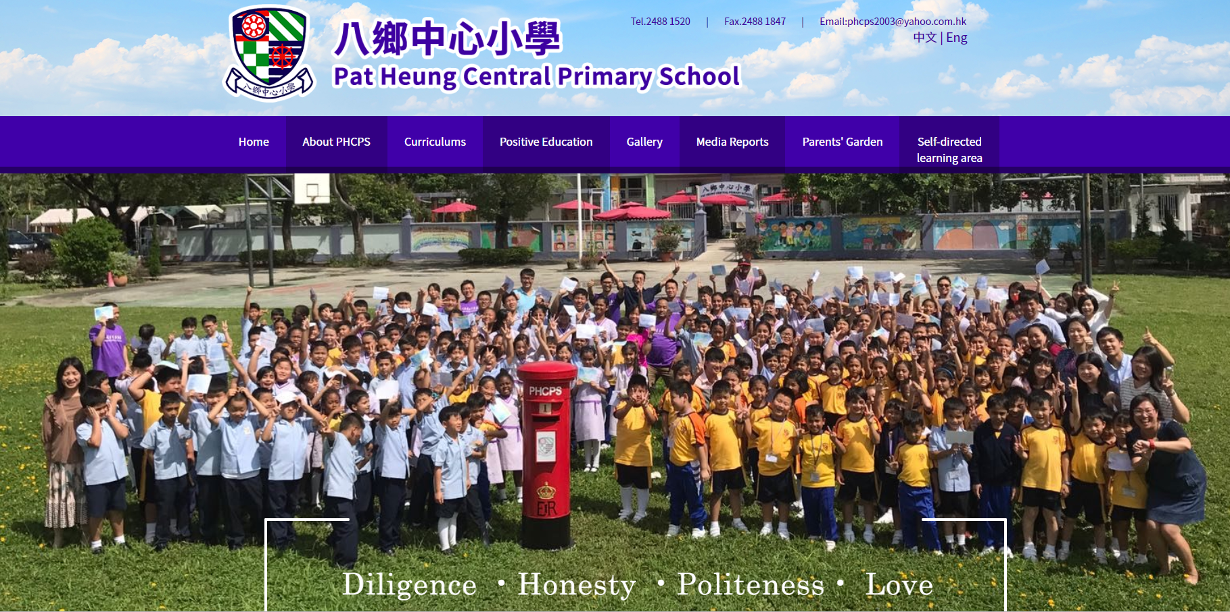
Phase 1
Executive Committee Meeting - Chairman

Slide 7
Objectives of the project
enabling NCS students to learn mathematics effectively
developing suitable school-based mathematics curriculum to cater for diversity of students
developing effective pedagogical strategies (particularly those with the five strategic focuses to be mentioned below) to cater for diverse learning needs of NCS students; and
developing effective learning, teaching and assessment (LTA) materials that facilitate NCS students’ learning in mathematics.

Slide 8
Objectives of the proposal
An extension of the USP primary mathematics project, as well as a consolidation & re-development of the last two USP projects, …
extending from numbers dimension to the whole primary mathematics curriculum;
refining a selection of better focused pedagogical strategies
making the ideas and materials more accessible to a wider community.
enabling NCS students to learn mathematics effectively
developing suitable school-based mathematics curriculum to cater for diversity of students
developing effective pedagogical strategies (particularly those with the five strategic focuses to be mentioned below) to cater for diverse learning needs of NCS students; and
developing effective learning, teaching and assessment (LTA) materials that facilitate NCS students’ learning in mathematics.

Slide 9
Five Themes
Activity first
Learning mathematics through games and activities
Beyond algorithm
Developing conceptual understanding as well as procedural knowledge of arithmetic operations
Culture matters
Exploring culture and values of ethnic minority students
Depth with fluency
Developing proficiency with number facts
Exercise counts
Illustrative examples and intelligent practice

Slide 10
Timeline
2019
SEP
2019-2020
SEP-JAN
2020
FEB-JUN
2020
JUN
2020
JUL-AUG
Phase 1
Phase 2a
Phase 2b
Phase 3
Phase 4
Collaborative investigation & Curriculum implementation
Consolidation & Refinement
Project setup & Familiarization
Collaborative investigation & Curriculum implementation
Dissemination & Overall evaluation
Reporting & Packaging of deliverables

Slide 11
Timeline
2019
SEP
2019-2020
SEP-JAN
2020
FEB-JUN
2020
JUN
2020
JUL-AUG
Collaborative investigation & Curriculum implementation
(Consolidation & Refinement)
Phase 1
Phase 2a
Phase 2b
Phase 3
Phase 4
Project setup & Familiarization
SEP 2019
Executive Committee Meeting I (27 Sept)
Briefing on the project organisation
Sharing on the successful experiences
Introduction to the pedagogic strategies in focus
→ 5 Themes
Preparatory meetings
Consent of participant students, parents and teachers
Assessment of current situation
Collaborative investigation & Curriculum implementation
Dissemination & Overall evaluation
Reporting & Packaging of deliverables

Slide 12
Timeline
2019
SEP
2019-2020
SEP-JAN
2020
FEB-JUN
2020
JUN
2020
JUL-AUG
Oct 2019
Thematic Sharing Sessions (29 Nov)
Dec 2019
Joint-school Workshop I - Sharing of ongoing works on each of the 5 themes
(13 Dec)
Sep2019-Jan2020
1st Round School-based support activities –
3 CLP meetings *
3 LOs * *at least
Collaborative investigation & Curriculum implementation
(Consolidation & Refinement)
Phase 1
Phase 2a
Phase 2b
Phase 3
Phase 4
Project setup & Familiarization
Collaborative investigation & Curriculum implementation
Dissemination & Overall evaluation
Reporting & Packaging of deliverables

Slide 13
Timeline
2019
SEP
2019-2020
SEP-JAN
2020
FEB-JUN
2020
JUN
2020
JUL-AUG
Feb 2019-May2020
2nd Round School-based support activities –
3 CLP meetings*
3 Los * *at least
Apr 2020
Thematic Sharing Sessions
Apr 2020
Joint-school Workshop II - Sharing of ongoing works on each of the 5 themes
Collaborative investigation & Curriculum implementation
(Consolidation & Refinement)
Phase 1
Phase 2a
Phase 2b
Phase 3
Phase 4
Project setup & Familiarization
Collaborative investigation & Curriculum implementation
Dissemination & Overall evaluation
Reporting & Packaging of deliverables

Slide 14
Timeline
2019
SEP
2019-2020
SEP-JAN
2020
FEB-JUN
2020
JUN
2020
JUL-AUG
Collaborative investigation & Curriculum implementation
(Consolidation & Refinement)
Phase 1
Phase 2a
Phase 2b
Phase 3
Phase 4
Project setup & Familiarization
Collaborative investigation & Curriculum implementation
Dissemination & Overall evaluation
Reporting & Packaging of deliverables
Jun 2020
Executive Committee Meeting II
Jul 2020
Territory-wide dissemination seminar
Jul-Aug 2020
Packaging the deliverables
Aug 2020
Preparing Final Report & Audit Report

Slide 15
Timeline
2019
SEP
2019-2020
SEP-JAN
2020
FEB-JUN
2020
JUN
2020
JUL-AUG
Phase 1
Phase 2a
Phase 2b
Phase 3
Phase 4
Collaborative investigation & Curriculum implementation
Consolidation & Refinement
Project setup & Familiarization
Collaborative investigation & Curriculum implementation
Dissemination & Overall evaluation
Reporting & Packaging of deliverables

Slide 16
Major network activities across 16 Network Schools
One Briefing / Introduction Session at the beginning (3 hours)
Two Joint-school Workshops (3 hours each, sharing good practices conducive to better learning and teaching of mathematics for NCS students)
Two Thematic Sharing Sessions (2 hours each, for teachers interested in any of the five themes of pedagogic strategies)
Dissemination Seminar (3 hours)

Slide 17
Phase 4:
Reporting & Packaging of deliverables
Project website :
Explanatory examples of pedagogical strategies
General suggestions and advices on teaching mathematics to students of cultural and linguistic diversity
Downloadable worksheets (in Word and PDF formats)
Applets (e.g. GeoGebra applets)
PowerPoint slides
Short video-clips
URLs linking to existing online resources
Printed booklets, quick reference cards or flashcards :
Small printouts (pedagogical principles and/or some interesting mathematical ideas) *around 200 copies
E-version will be made available at Project website.

Slide 18
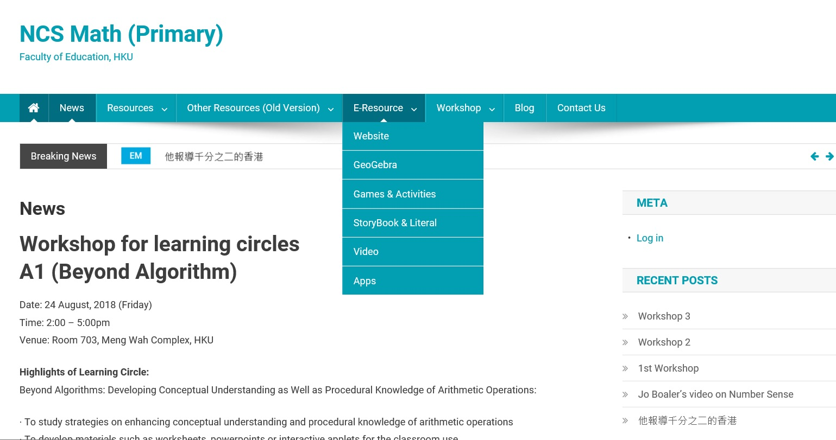

Slide 19


Slide 20
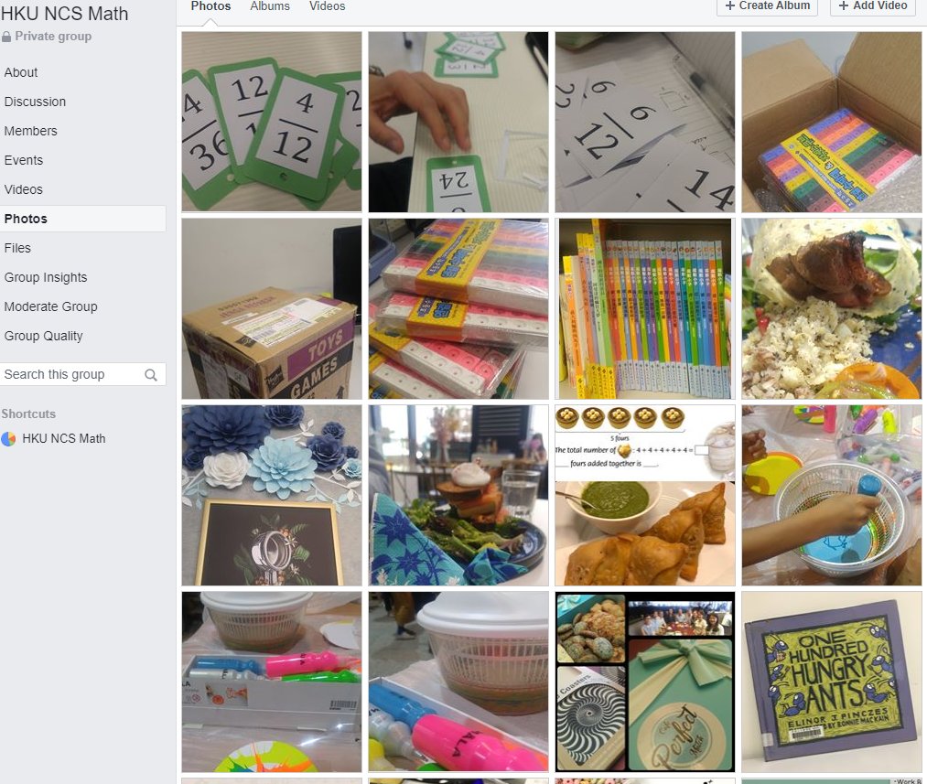

Slide 22
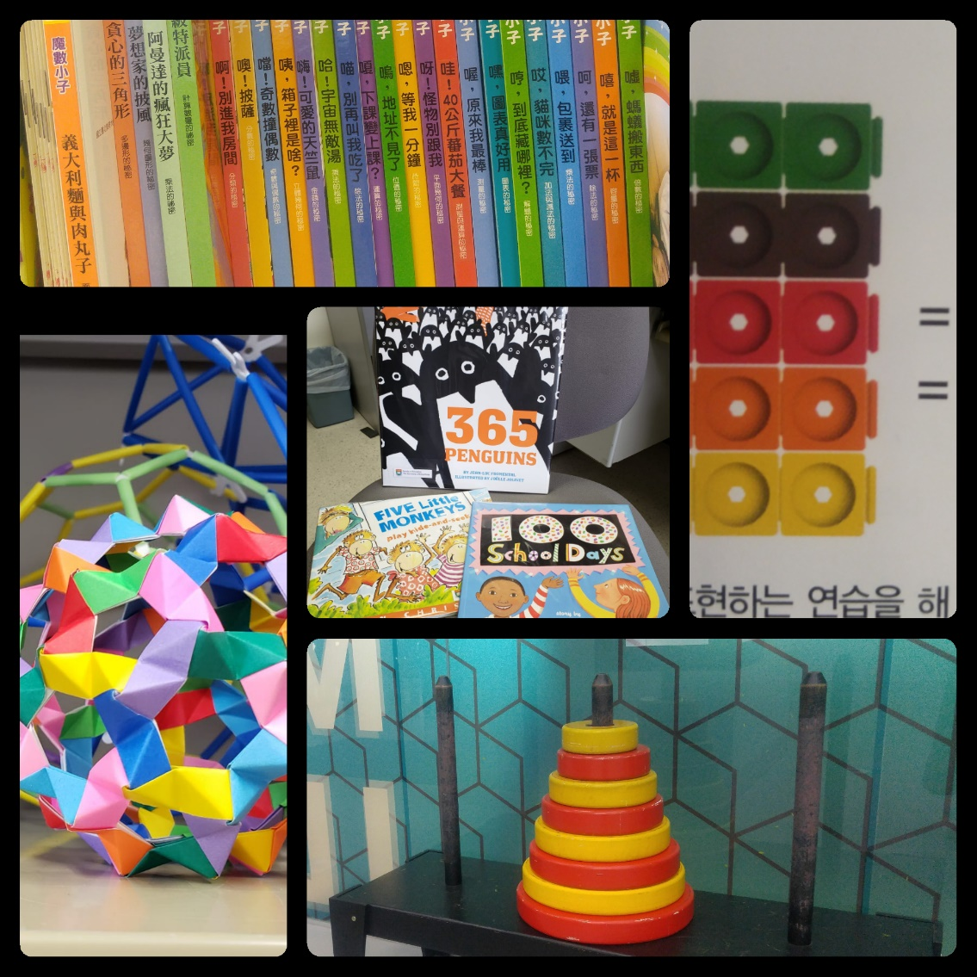
Phase 1:
Assessment of current situation
Number Cards – throughout P.1
Manipulative Tool –
throughout P.1-P.6
Storytelling –Eng.Team
  Cultural and Linguistic Diversity

Slide 23



School-based Support Activities
Five Themes
Roles of teachers

Slide 24
