Slide 1
Culture (& Language) matter! teaching MATHEMATICS in multicultural & multilingual classrooms
Emily SUM

Slide 2
OBJECTIVES
Multiculturalism & Multilingualism in Mathematics Classrooms
To identify and understand the characteristics/distinctiveness about the teaching and learning in multicultural and multilingual classrooms;
To design and implement culturally and linguistically responsive mathematics curriculum (including teaching strategies, language of instructions, resource materials) for learner diversity; and
To improve mathematics learning through language especially for students who are learning English/Cantonese.
Notes:
The curriculum supports and empowers all learners to learn and achieve personal excellence, regardless of their individual circumstances.

Slide 3
What HK students value in maths learning?
The characteristics of ethnic minority (EM) students with regard to mathematical learning.
291 participants (P4, 5 & 6 from five project schools)
Ethnic minorities (62.2%) and ethnic Chinese (37.8%)
English (20.3%), Chinese (19.9%), Urdu (12.4%) Nepali (7.9), PTH (7.9%)
Mixed method: Quantitative (WIFI questionnaire; Principal Component Analysis & Analysis of Variance) and qualitative (focus group interview; grounded theory).

Slide 4
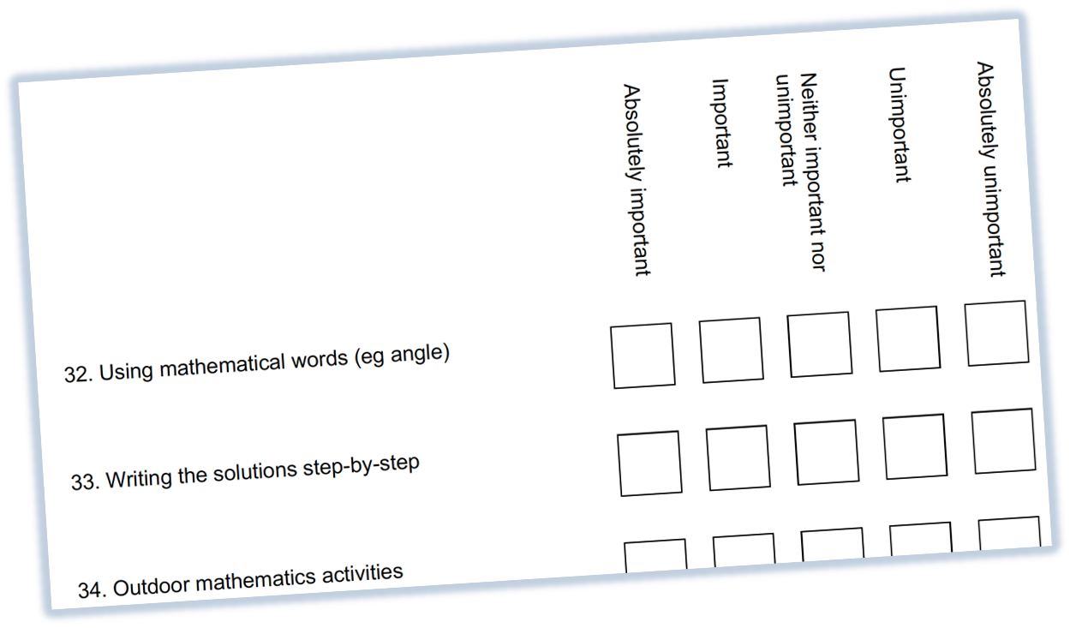
Methodology
Questionnaire method using Section A of the WIFI questionnaire
Teacher Questionnaire: Teachers at the participating schools
Student Questionnaire: P4 – 6 students at the participating schools; students in the participating classes
Parent Questionnaire: Parents of students in the participating classes

Slide 5
Top Five Components
Principal Component Analysis: components from 38 items, explaining 49.29% of total variance
C1: Knowledge
Knowing the steps of the solution (Q56), which formula to use (Q58, Q38), and concepts processes (Q54)
C4: Product
Looking for different possible answers (Q16) and ways to find the answer (Q15) and memorising facts (Q14)
C6: Process
C9: Exposition
Completing work (Q61), knowing the theoretical aspects (Q59), and understanding correct/incorrect solutions (Q63)
C11: Effort
Explaining by the teacher (Q5) and working step by step (Q6)
C15: Right answer
Working out the maths by myself (Q42)
Getting the right answer (Q50)
Ethnic Minorities | Ethnic Chinese
Exposition | Exposition
Product | Right answer
Knowledge | Product
Process | Process
Effort | Knowledge

Slide 6
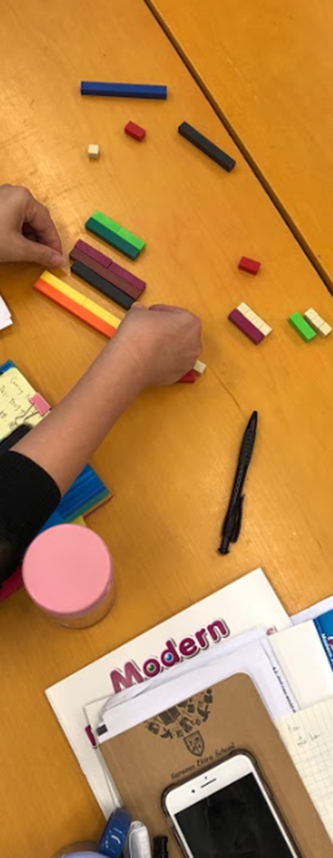
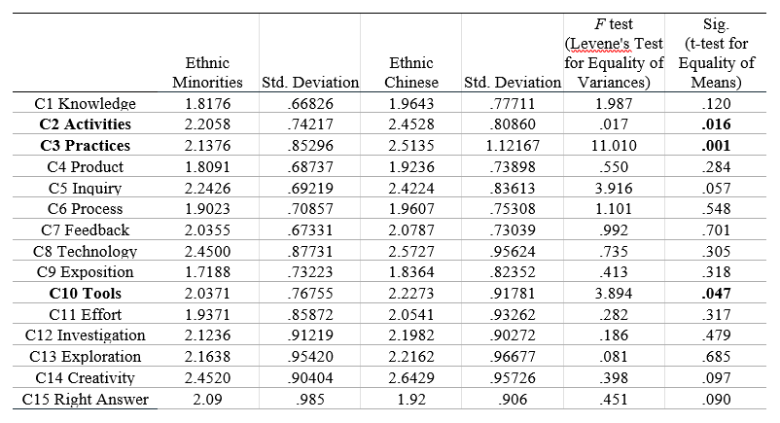
What students value
ANOVA was conducted to explore the cultural differences between Ethnic Chinese (EC) and Ethnic Minorities (EM). EM seems to value the attributes more, except C15.

Slide 7
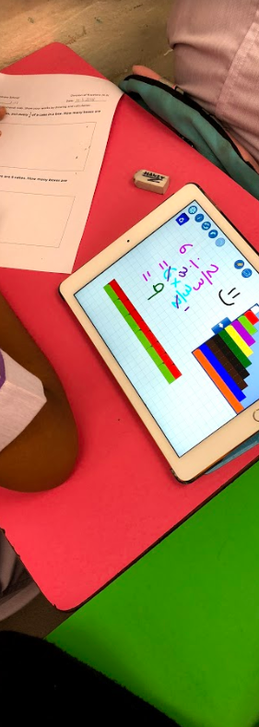
Difference in Valuing between EM & EC
Based on Levene’s Test for equality of variances…
C2 Activities
Mathematics Games
Stories about Mathematics/ Mathematicians/
C3 Practices
Practicing with lots of Questions
Doing a lot of Maths Work
Outdoor Mathematics Activities
Maths Homework
C10 Tools
Using Diagrams
Using Concrete Materials

Slide 8
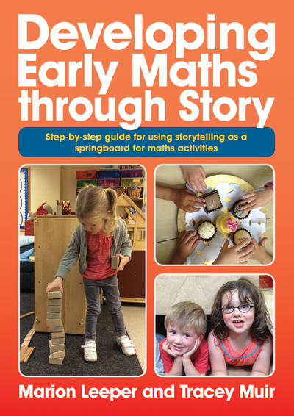
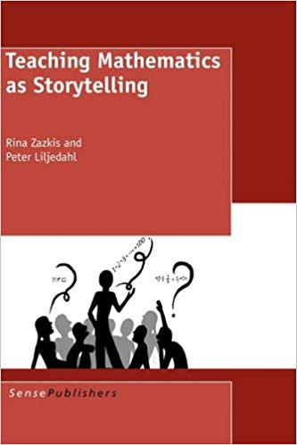
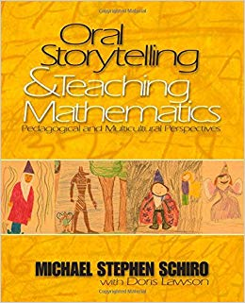
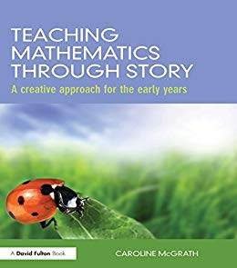
Activities
Teaching Mathematics As Storytelling
Informal, conversational manner support students’ participation in mathematical discussions;
Connect students’ experiences with school mathematics;
Offers multiple entry points for students to engage with the story, to pose questions and solve problems;
Help students to express their mathematical ideas/thinking as they develop problem solving skills and learning the language.

Slide 9
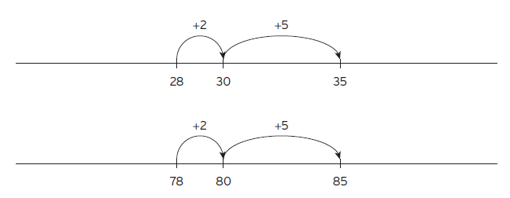
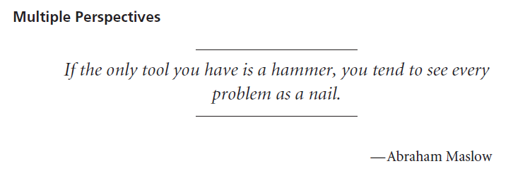
practices
Balance between Conceptual Understanding and Procedural Fluency
Students can show their conceptual understanding not by giving an answer or describing a procedure; but by
Using multiple representations (including objects, pictures, words, symbols, tables and graphs etc.), which provide a resource for students to show ideas/thinking, and these can be accompanied by oral or written explanations.

Slide 10
Tools
Teaching Tripod
Engage students in mathematical TASKS by using appropriate TOOLS strategically.
Use TOOLS to make lessons comprehensible and to enhance classroom discourse;
Support students in using emerging and imperfect language to communicate their mathematical thinking and reasoning.

Slide 11
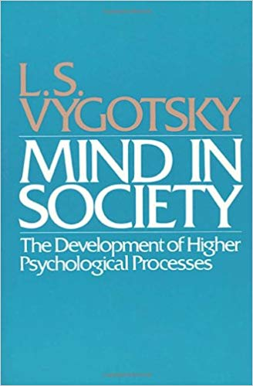
Language
Physical tools and psychological tools (Vygotsky, 1978)
“The language of mathematics” not to mean a list of vocabulary or technical words with precise meanings but the communicative competence necessary and sufficient for competent participation in mathematical discourse practices (Moschkovich, 2011);
Second-language-acquisition occurs most successfully in instructional contexts that are language-rich, actively involve students in using language, require both receptive and expressive understanding, and require students to use words in multiple ways over extended periods of time (Blachowicz and Fisher, 2000; Pressley, 2000).

Slide 12
Recommendations for Maths Instruction
Moschkovich (2011)
Treat language as a resource, not a deficit (Gándara and Contreras, 2009; Moschkovich, 2000) and support all students regardless of their language proficiency;
Address much more than vocabulary and support students’ participation in mathematical discussions as they learn English (Moschkovich, 1999, 2002, 2007a, 2007b, 2007d), focus on important mathematical concepts/content rather than on linguistic skills.
Draw on multiple resources available in classrooms – such as objects, drawings, graphs, and gestures – as well as languages and experiences outside of school.

Slide 13
TASKS, TOOLS & TALK
Supporting the mathematics learning for cultural and linguistic diversity in mathematics classroom
TASKS/TOOLS
TALK
Focus on important mathematical concepts and reasoning, rather than on language skills;
Involve multiple representations (including objects, pictures, words, symbols, tables, graphs, etc.);
Leverage familiar cultural contexts and students’ home and community-based knowledge and experiences;
Maintain the rigor/high-cognitive-demand; and
Assessments should include oral reports and other presentations rather than relying only on written or one-time assessments.
Use strategic questioning and references to student work to refine students’ mathematical thinking and ideas; to clarify misconceptions and confusion (if any);
Offer opportunities for students to participate actively and make valuable contributions to mathematical discussions in a variety of participation structures (teacher-led, small group, pairs, student presentations, etc.);
Provide multiples opportunities for students to read and write about their mathematics learning, gives students written feedback that purposefully focuses on mathematical language development; and
Build on students’ everyday language while developing their mathematical language through interaction, scaffolding, and other supports.

Slide 14
THANK YOU

