Slide 1

HKU Summer Institute
Higher Education
for Tomorrow: Changes, Challenges, Choices
Measures to enhance building of innovation capacity of teaching and research staff
of HEIs of Macau
Aaron Fong, Jun 27, 2019

Slide 2
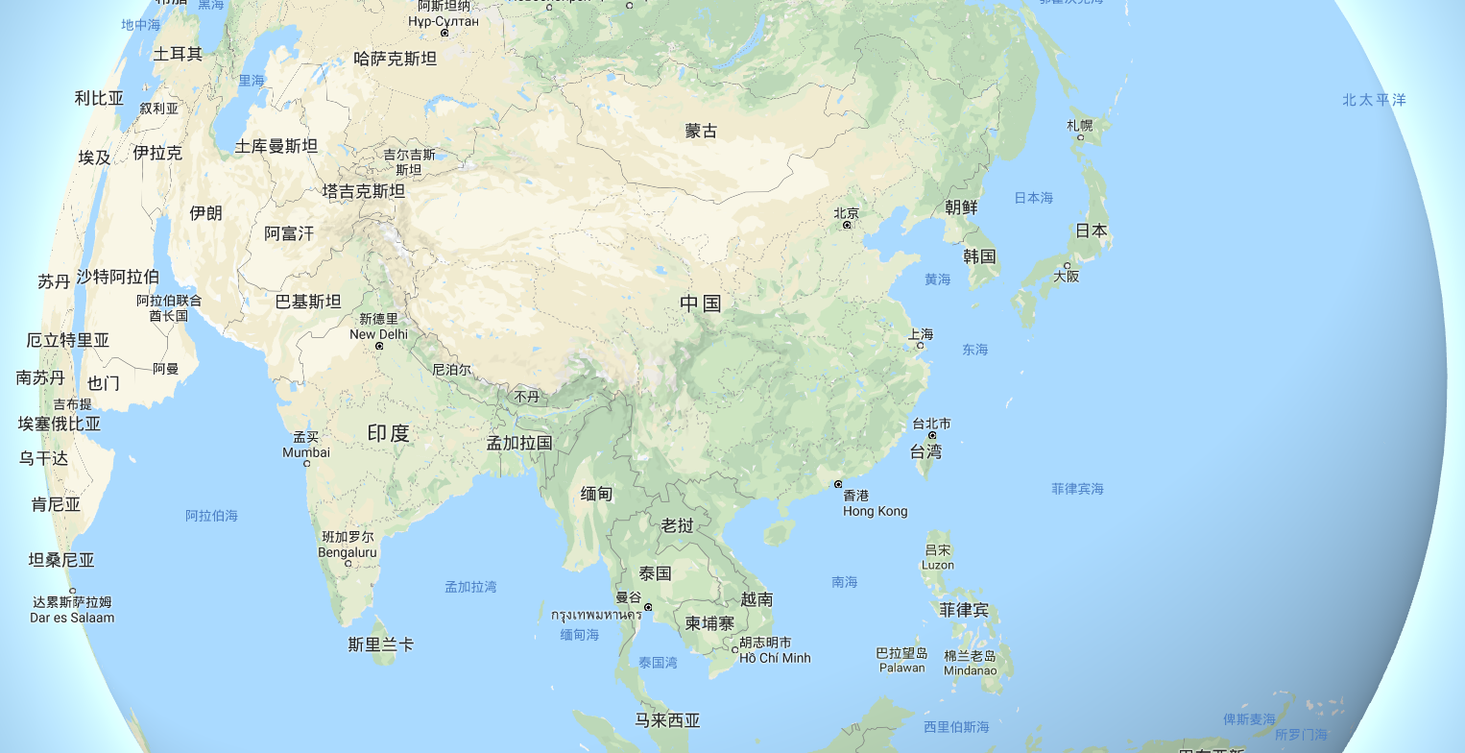
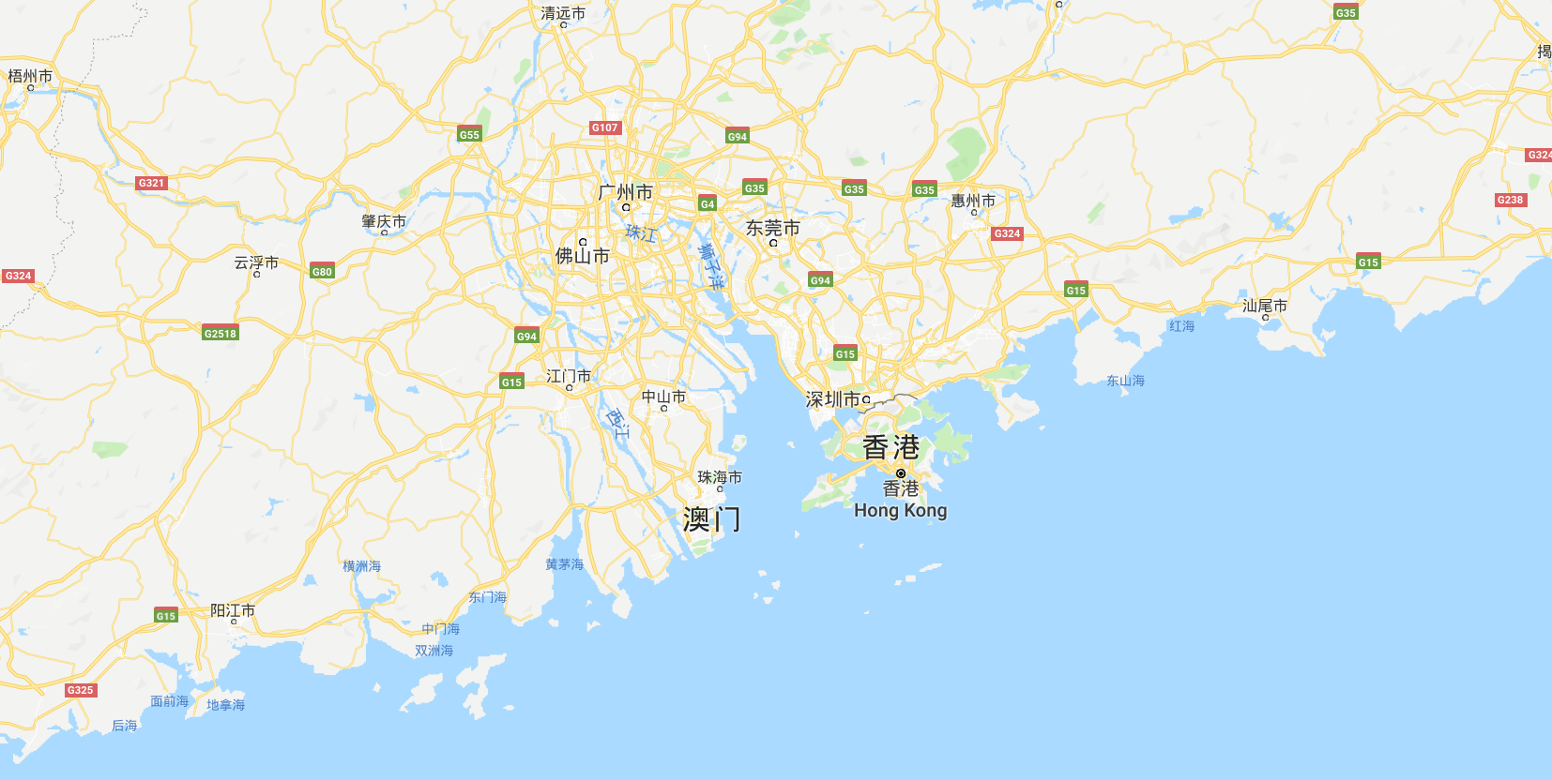
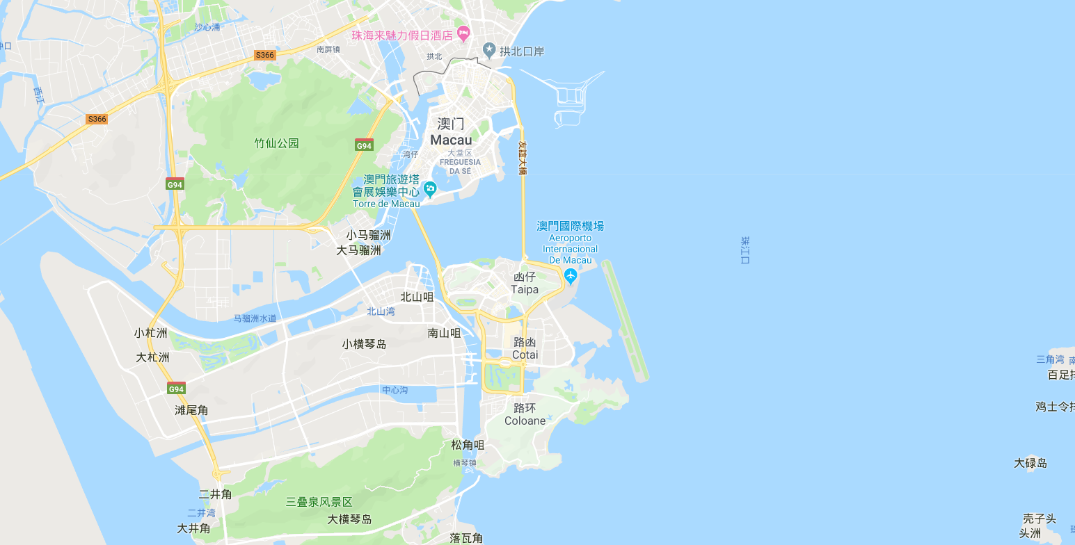
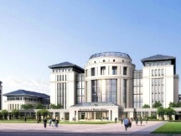
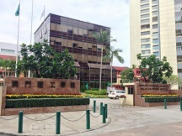
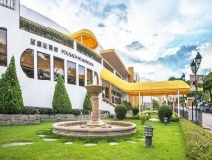
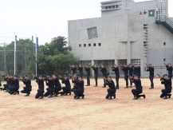
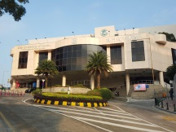
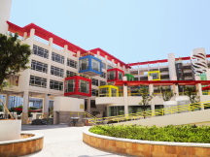

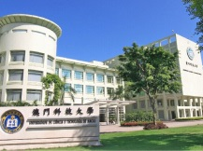
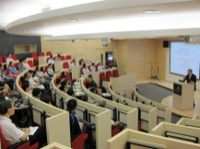
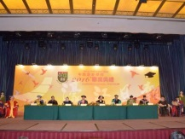
General Overview
GuangZhou
Mongolia
Macau
peninsula
Higher
Education
Institutions
China
Macao
Polytechnic
Institute
Institute for
Tourism
Studies
ShenZhen
Academy of
Public Security
Forces
University of
Macau
Taipa
(Island)
Cotai
(Reclamation)
Hengqin
Macau
myanmar
Macau
Coloane
(Island)
Cambodia
Kiang Wu
Nursing
College
Macau University
of Science
and Technology
Macau
Institute of
Management
Macau
Millennium
College
City University
of Macau
University of
Saint Joseph

Slide 3
34,279
Registered Students, 2018/2019
General Overview
16,287
47.51%
17,992
52.49%
33,81098.63%
469
1.37%
Local
Students
Non-local
Students
Full-time
Students
Part-time
Students
2,562
7.47%
6,189
18.05%
276
0.81%
25,061
73.11%
191
0.56%
Diploma
(incl. Associate
Diploma)
Post-graduate
Diploma
Doctorates
Master
Bachelor

Slide 4
34,279
Registered Students, 2018/2019
General Overview
Mainland 16,919
Hong Kong 401
Taiwan 83
International 589
Asia 192
Europe 160
Africa 156
N. America 26
S. America 48
Oceania 7
16,287
47.51%
17,992
52.49%
Mainland 16,919
Hong Kong 401
Taiwan 83
International 589
Asia 192
Europe 160
Africa 156
N. America 26
S. America 48
Oceania 7
33,81098.63%
469
1.37%
Local
Students
Non-local
Students
Full-time
Students
Part-time
Students
2,562
7.47%
6,189
18.05%
276
0.81%
25,061
73.11%
191
0.56%
Diploma
(incl. Associate
Diploma)
Post-graduate
Diploma
Doctorates
Master
Bachelor

Slide 5
5,236
HE staff, 2018/2019
General Overview
Full-time
Local
62%
67%
Full-time
Local
Teaching
Staff
Full-time
Local
98%
89%
51%
37%
38%
33%
Research
Staff
Admin.
Staff
Part-time
Non-local
2%
11%
52%
63%
Part-time
Non-local
Part-time
Non-local

Slide 6
18,796
Students studying outside Macau, 2017/2018
General Overview
Asia (others)
131
N. America
894
Europe
1,417
Mainland 9,080
Hong Kong 1,847
Taiwan 4,828
S. America
1
Oceania
598

Slide 7
General Overview
HE programs
280
Progression rate
92.86% (2017/2018)
HEIs
University of Macau
Macao Polytechnic Institute
Institute for Tourism Studies
Academy of Public Security Forces
City University of Macau
University of Saint Joseph
Kiang Wu Nursing College
Macau University of Science and Technology
Macau Institute of Management
Macau Millennium College
Registered Students
34,279
HE GER
85.27%
Teaching Staff
2,453
Labor force HE level
36.43%
Research Staff
478
Local employment HE level
38.12%
Administrative Staff
2,455
HE expenditures
4.77% (2017)
Students abroad
18,796 (2017/2018)
HE expenditure GDP
0.91% (2016)

Slide 8
The development and reform of the HE system of Macau
The new HE regime and the supporting regulations of Macau effective starting Aug 7, 2018
The restructure and reorganization of the HE government department.
The new department and function relating to the R&D affairs.
The new-setup HE Fund.

Slide 9
The development and reform of the HE system of Macau
Higher Education Committee
Director &
Vice Directors
Higher Education Fund
Department of HEIs Coordination
Department of HE Students
Department of HE Cooperation, Science and Technology
Department of General Affairs
The new HE regime and the supporting regulations of Macau effective starting Aug 7, 2018
The restructure and reorganization of the HE government department.
The new department and function relating to the R&D affairs.
The new-setup HE Fund.
Division of HE Quality Assurance
Division of HE Students Support Services
Division of Legal and Translation
Division of Resources and Student Welfares
Division of Research and Planning
Center for HE Students
Division of Administrative and Financial Affairs
Division of Information

Slide 10
Action Plan
Problem
facing
Project
proposals
Potential
obstacles
and
difficulties
Projected
results
Promotions

Slide 11
Action Plan
Problem
facing
Problem facing:
There are only a few private research firms, research mainly rely on HEIs.
Some HEIs not paying enough attention on research, insufficient investment on research.
HE fund provides subsidy Scheme for the Macau HEIs, and for HE teaching and research staff for their professional development, but the HE fund is established newly, still need more promotions.
Professionals don’t pay much attention of the research work, and hence couldn’t coordinate well with the GBA Outline Development Plan.
Professionals might not care about the development of mainland and the region.
Project
proposals
Promotions
Potential obstacles
And difficulties
Projected
results

Slide 12
Action Plan
Project proposals:
Innovation Enhancing Program at the GBA for the Young Professionals
  Objectives: To establish more platforms, to let the young professionals know more about the importance of doing the research work; to let them know more about the development outside Macau especially the GBA region; and to let them establish connections and facilitate the cooperations with the industries in the GBA region.
  Target groups: teaching and research staff ages under 40.
  Content: 6-day program held in July, in Guangzhou, Shenzhen and other cities in the GBA, including training sessions by the researchers of the universities in Guangzhou and Shenzhen, Site visits to the research centers, innovation and incubation centers, group sharing and discussion with the local young professionals
  Budget: MOP200,000.
Problem
facing
Project
proposals
Promotions
Potential obstacles
And difficulties
Projected
results

Slide 13
Action Plan
Problem
facing
Project
proposals
Promotion Strategies:
  Advertising & Newspapers
  FB, Wechat, IG & webpage news
  Direct contact with the HEIs
Promotions
Potential obstacles
And difficulties
Projected
results

Slide 14
Action Plan
Problem
facing
Project
proposals
Obstacles, difficulties and solutions:
  Responses and attitudes of HEIs.
  Number of applicants.
  Research skills of the young professionals.
  Sufficient communications with HEIs and providing quota for recommendation.
  Connections with the local target organizations.
Promotions
Potential obstacles
And difficulties
Projected
results

Slide 15
Action Plan
Problem
facing
Project
proposals
Promotions
Projected results:
  Expected feedbacks
  Evaluations forms
  Conclusion & sharing meeting
  It’s not the end when this program finish: the follow-up funding schemes.
Potential obstacles
And difficulties
Projected
results

Slide 16
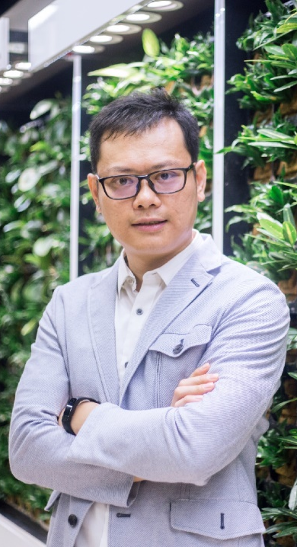
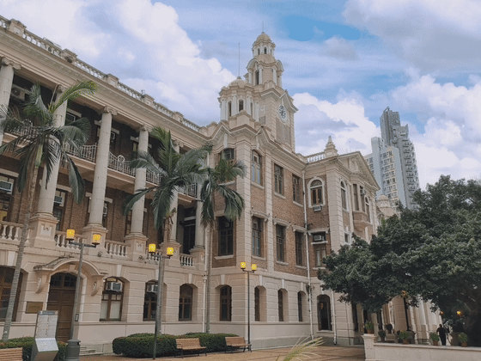

THANKS
Aaron Fong
Division of Research and Planning,
Higher Education Bureau,
Government of the Macau SAR
(+853) 66610110 (Telegram)
aaron@dses.gov.mo
aronfonn@hotmail.com

